Slide 1
Chapter 20 Carboxylic Acids and Nitriles

Slide 2
Learning Objectives
(20.1)
Naming carboxylic acids and nitriles
(20.2)
Structure and properties of carboxylic acids
(20.3)
Biological acids and the Henderson-Hasselbalch equation
(20.4)
Substituent effects on acidity

Slide 3
Learning Objectives
(20.5)
Preparing carboxylic acids
(20.6)
Reactions of carboxylic acids: An overview
(20.7)
Chemistry of nitriles
(20.8)
Spectroscopy of carboxylic acids and nitriles

Slide 4
Carboxylic Acids (RCO₂H)
Starting materials for acyl derivatives
Abundant in nature from oxidation of aldehydes and alcohols in metabolism
Acetic acid, CH₃CO₂H
Butanoic acid, CH₃CH₂CH₂CO₂H
Long-chain aliphatic acids

Slide 5
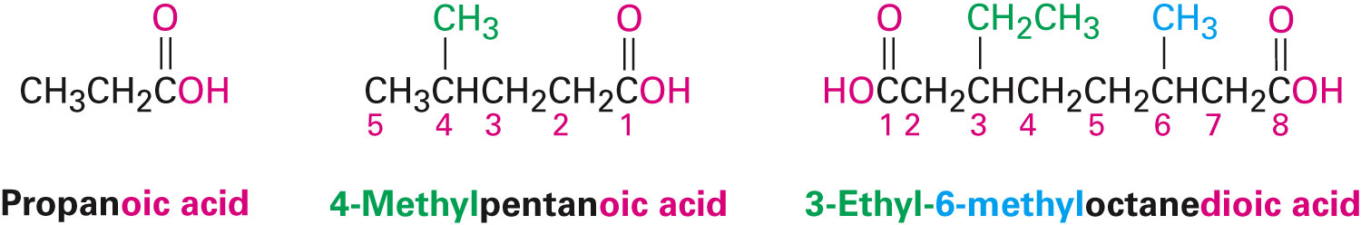
Naming Carboxylic Acids and Nitriles
Carboxylic Acids, RCO₂H
Derived from open-chain alkanes, the terminal -e of the alkane is replaced with -oic acid
The carboxyl carbon atom becomes C1
Notes:
Naming carboxylic acids and nitriles

Slide 6
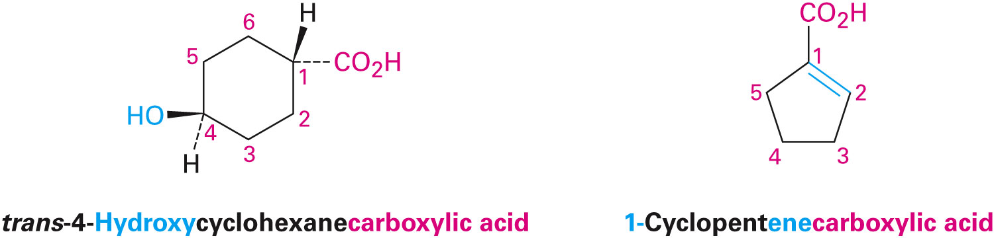
Naming Carboxylic Acids and Nitriles
Compounds with –CO₂H bonded to a ring are named using the suffix –carboxylic acid
The CO₂H carbon is not numbered in this system
As a substituent, the CO₂H group is called a carboxyl group
Notes:
Naming carboxylic acids and nitriles

Slide 7
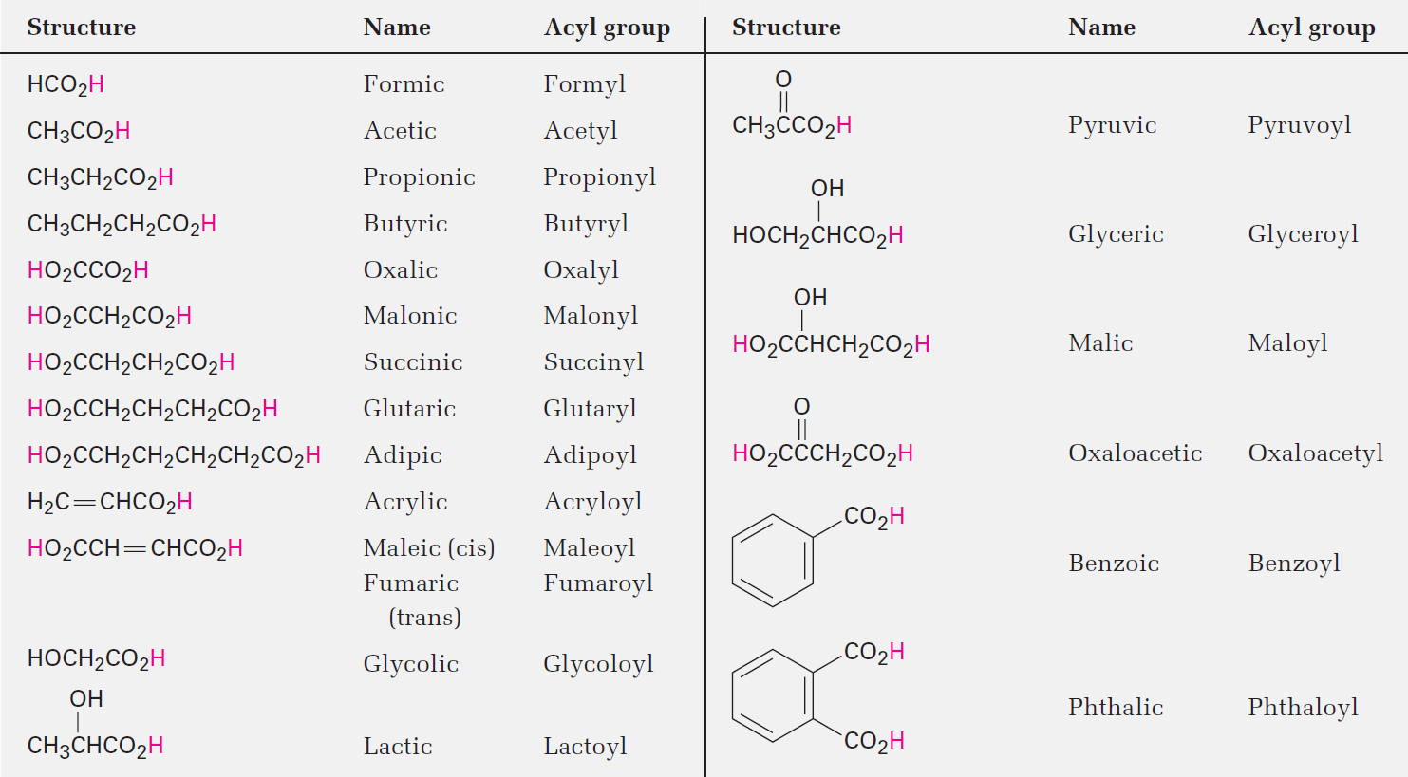
Table 20.1 - Common Names of Some Carboxylic Acids and Acyl Groups
Notes:
Naming carboxylic acids and nitriles

Slide 8
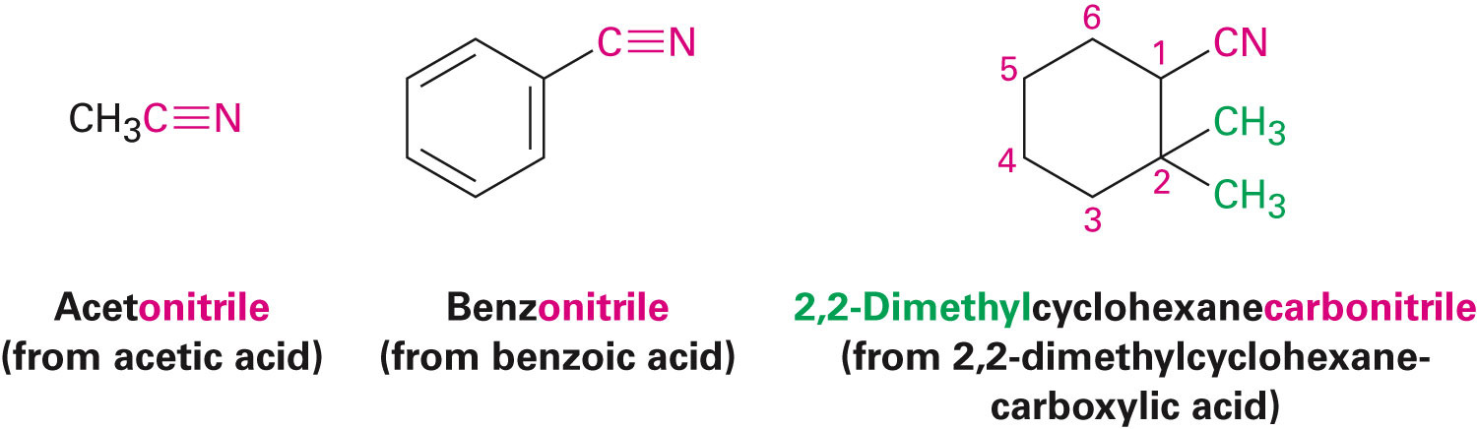
Naming Carboxylic Acids and Nitriles
Nitriles, RC≡N
Compounds containing the –C≡N functional group
Simple open chain nitriles are named by adding nitrile as a suffix to the alkane name
Nitrile carbon numbered C1
Also named as derivatives of carboxylic acids
Replacing the -ic acid or -oic acid ending with –onitrile
Replacing the –carboxylic acid ending with -carbonitrile
Notes:
Naming carboxylic acids and nitriles

Slide 9
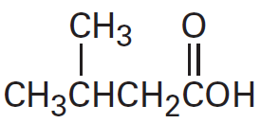
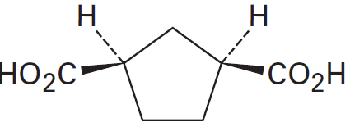
Worked Example
Give IUPAC names for the following compounds:
a)
b)
Solution:
a) 3-Methylbutanoic acid
b) cis-1,3-Cyclopentanedicarboxylic acid
Notes:
Naming carboxylic acids and nitriles

Slide 10
Structure and Properties of Carboxylic Acids
Carboxyl carbon sp² hybridized
Groups are planar with C–C=O and O=C–O bond angles of approximately 120°
Forms hydrogen bonds, existing as cyclic dimers held together by two hydrogen bonds
Causes higher boiling points than the corresponding alcohols
Notes:
Structure and properties of carboxylic acids

Slide 11
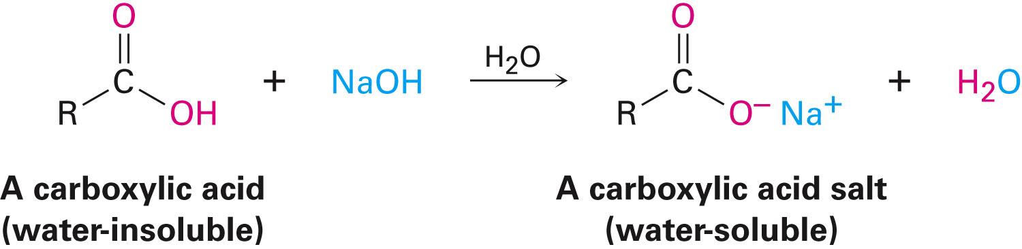
Dissociation of Carboxylic Acids
Carboxylic acids are proton donors toward weak and strong bases
Produces metal carboxylate salts, RCO₂– M⁺
Carboxylic acids with more than six carbons are slightly soluble in water
Conjugate base salts are water-soluble
Notes:
Structure and properties of carboxylic acids

Slide 12
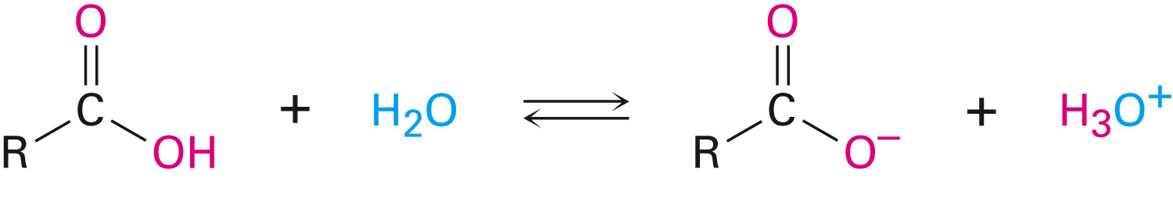
Acidity Constant and pKa
Carboxylic acids transfer a proton to water to give H₃O⁺ and carboxylate anions, RCO₂⁻
Acidity constant, Ka, is about 10⁻⁴ to 10⁻⁵ for a typical carboxylic acid
Gives the extent of acidity dissociation
Notes:
Structure and properties of carboxylic acids

Slide 13
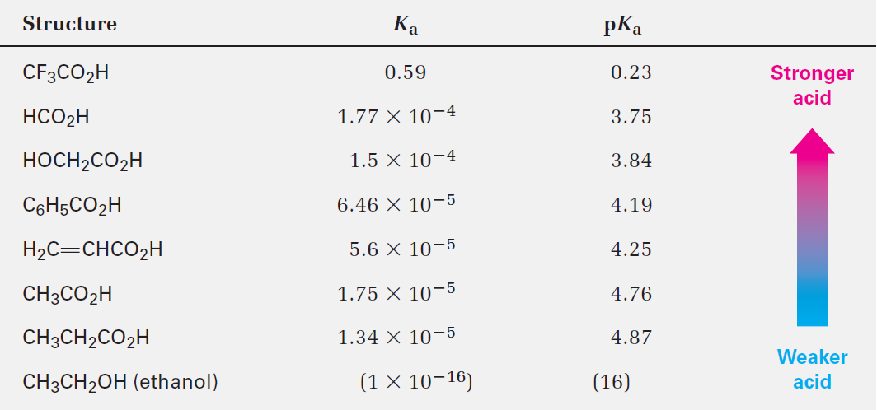
Table 20.3 - Acidity of Some Carboxylic Acids
Notes:
Structure and properties of carboxylic acids

Slide 14
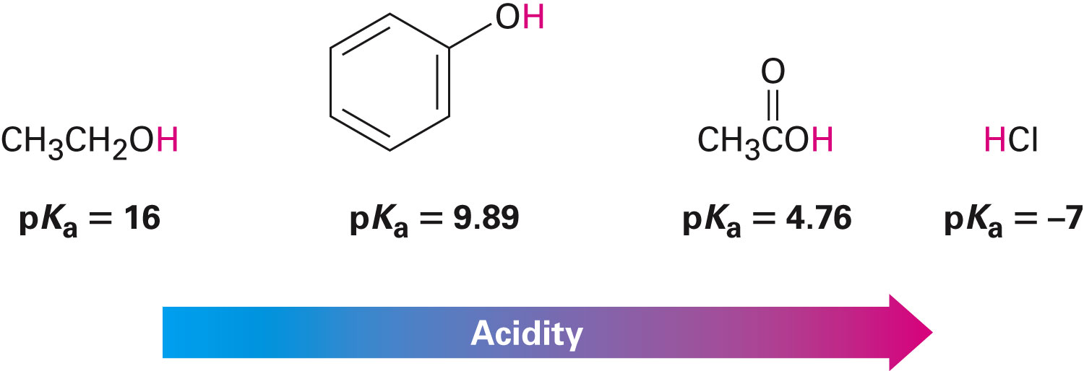
Caboxylic Acid
Carboxylic acids are more acidic than alcohols and phenols
Carboxylic acid dissociate to give carboxylate ion
Carboxylic ion is a stabilized resonance hybrid of two equivalent structures
Notes:
Structure and properties of carboxylic acids

Slide 15
Worked Example
The Ka for dichloroacetic acid is 3.32 ×10⁻²
Approximately what percentage of the acid is dissociated in a 0.10 M aqueous solution
Solution:
Cl₂CHCH₂H + H₂O Cl₂CHCO₂– + H₃O⁺
K_{a}
 | Initial molarity | Molarity after dissociation
Cl₂CHCH₂H | 0.10 M | 0.10 M –y
Cl₂CHCO₂– | 0 | y
H₃O⁺ | 0 | y
Notes:
Structure and properties of carboxylic acids

Slide 16
Worked Example
y =0.0434 M , (Using quadratic formula)
Notes:
Structure and properties of carboxylic acids

Slide 17
Biological Acids and the Henderson-Hasselbalch Equation
Henderson-Hasselbalch equation: Calculates the % of dissociated and undissociated forms when pKa of given acid and the pH of the medium are known
Rearranging
Henderson-Hasselbalch equation
Notes:
Biological acids and the Henderson-Hasselbalch equation

Slide 18
Worked Example
Calculate the percentages of dissociated and undissociated forms present in 0.0020 M propanoic acid (pK_{a} = 4.87) at pH = 5.30
Solution:
Notes:
Biological acids and the Henderson- Hasselbalch equation

Slide 19
Worked Example
73% of 0.0020 M propanoic acid is dissociated at pH = 5.30
Notes:
Biological acids and the Henderson- Hasselbalch equation

Slide 20
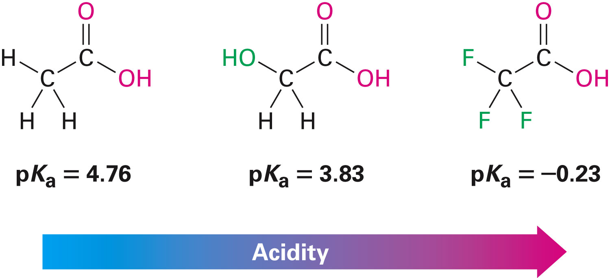
Substituent Effects on Acidity
Factors that stabilize the carboxylate anion relative to the undissociated carboxylic acid will drive the equilibrium toward increased dissociation and result in increased acidity
Inductive effects operate through σ bonds and are dependent on distance
Substituent moves farther from the carboxyl causing the effect of halogen substitution to decrease
Notes:
Substituent effects on acidity

Slide 21
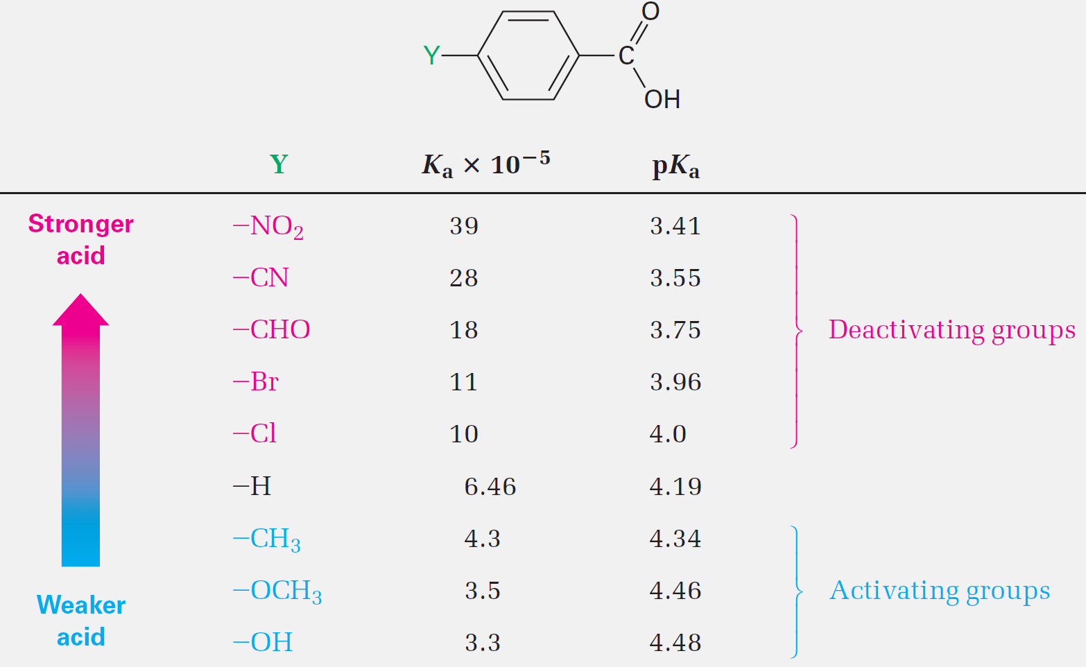
Table 20.4 - Substituent Effects on the Acidity of p-Substituted Benzoic Acids
Notes:
Substituent effects on acidity

Slide 22
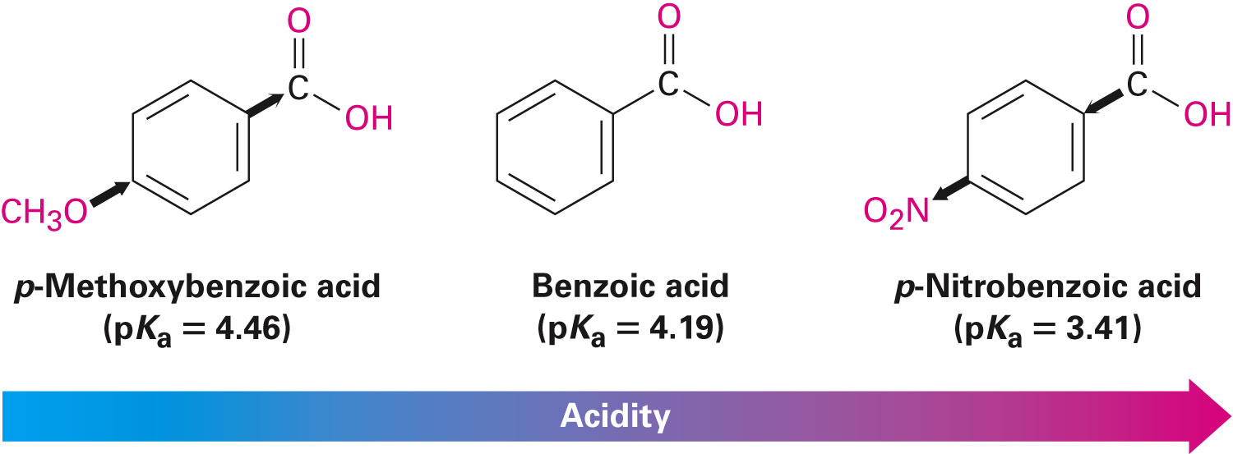
Aromatic Substituent Effects
An electron-withdrawing group increases acidity by stabilizing the carboxylate anion
Electron-donating group decreases acidity by destabilizing the carboxylate anion
By finding the acidity of the corresponding benzoic acid reactivity can be predicted
Notes:
Substituent effects on acidity

Slide 23
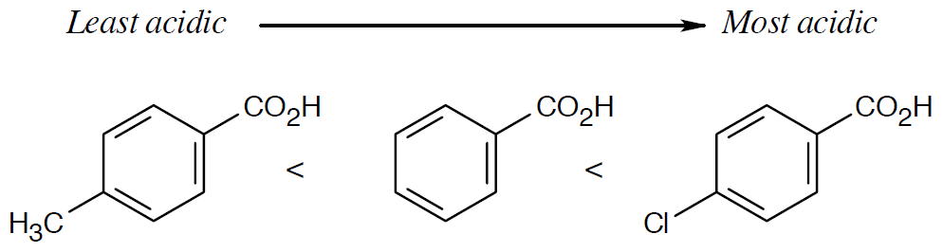
Worked Example
Rank the following compounds in order of increasing acidity, without using the table of pKa data
Benzoic acid, p-methylbenzoic acid, p-chlorobenzoic acid
Solution:
Electron-withdrawing groups increase carboxylic acid acidity and electron donating groups decrease carboxylic acid acidity
Notes:
Substituent effects on acidity

Slide 24
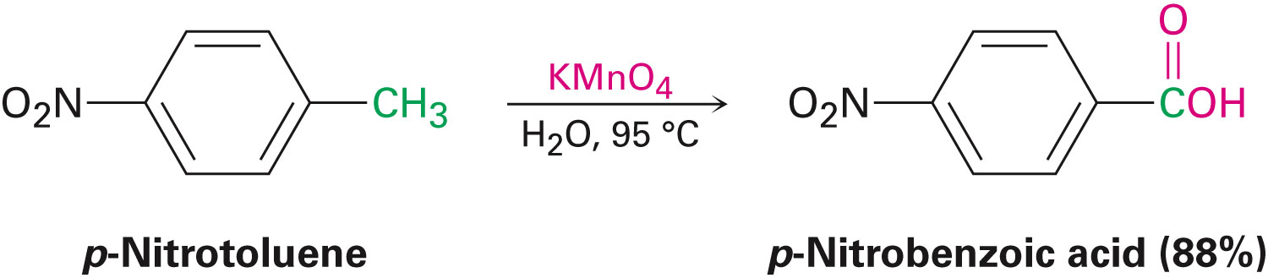
Preparing Carboxylic Acids
Oxidation of a substituted alkylbenzene with KMnO₄ or Na₂Cr₂O₇ gives a substituted benzoic acid
1°and 2°alkyl groups can be oxidized
Tertiary groups cannot
Notes:
Preparing carboxylic acids

Slide 25
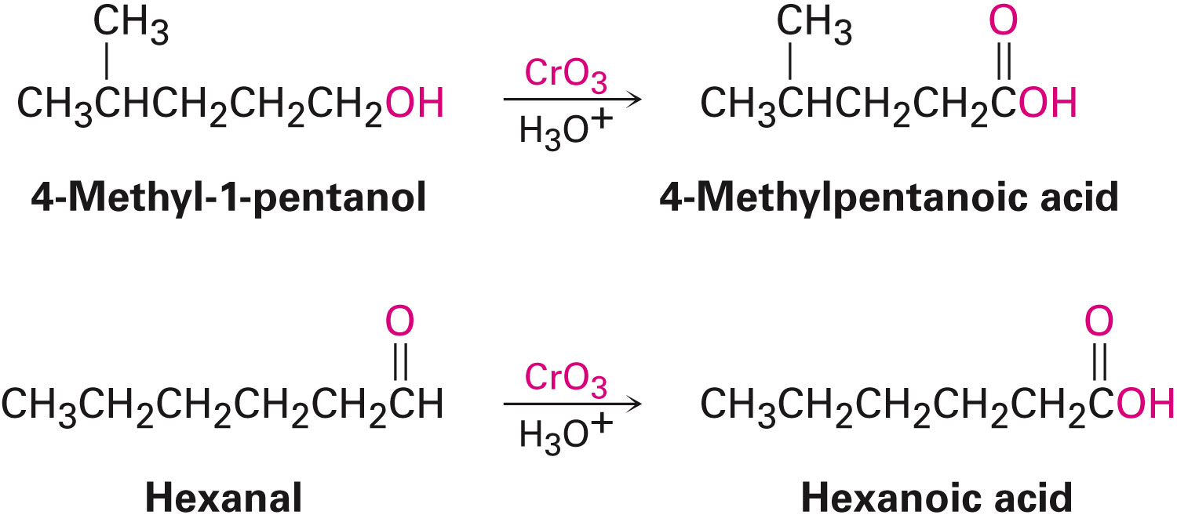
Preparing Carboxylic Acids
Oxidation of a primary alcohol or an aldehyde yields a carboxylic acid
1°alcohols and aldehydes are often oxidized with CrO₃
Notes:
Preparing carboxylic acids

Slide 26
Preparing Carboxylic Acids
Hydrolysis of nitriles
Nitriles on heating with acid or base yields carboxylic acids
Conversion of an alkyl halide to a nitrile followed by hydrolysis produces a carboxylic acid with one more carbon (RBr → RC≡N → RCO₂H)
Notes:
Preparing carboxylic acids

Slide 27
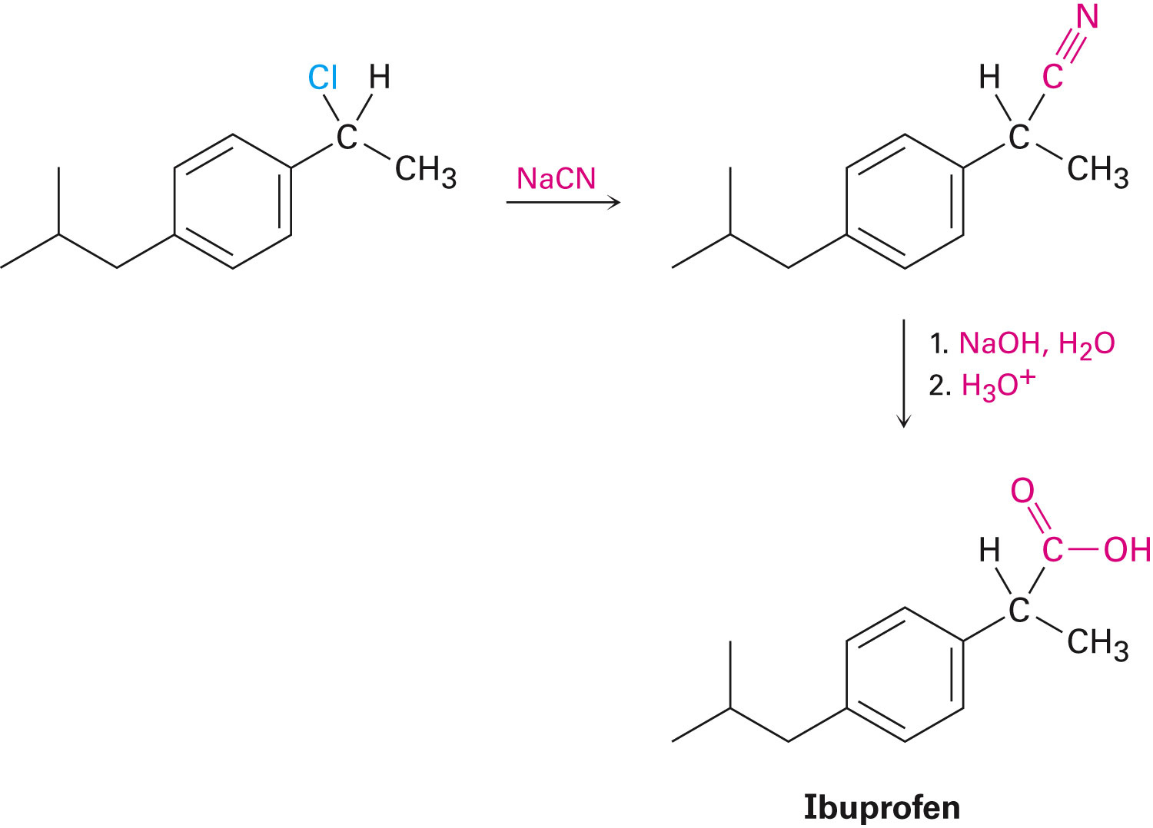
Preparing Carboxylic Acids
Notes:
Preparing carboxylic acids

Slide 28
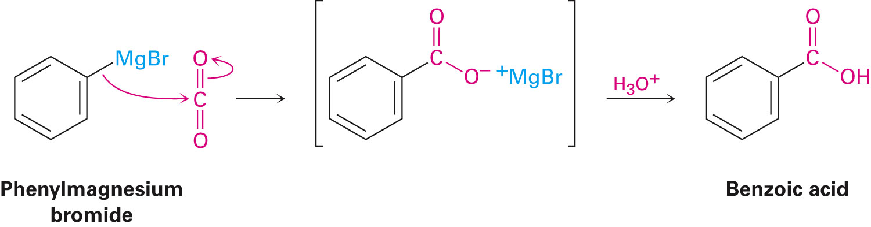
Preparing Carboxylic Acids
Carboxylation of Grignard Reagents
Grignard reagents react with dry CO₂ to yield a metal carboxylate
The organomagnesium halide adds to C=O of carbon dioxide
Protonation by addition of aqueous HCl in a separate step gives the free carboxylic acid
Notes:
Preparing carboxylic acids

Slide 29
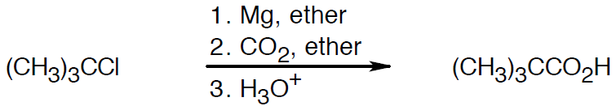
Worked Example
How is the following carboxylic acid prepared:
(CH₃)₃CCO₂H from (CH₃)₃CCl
Solution:
Since the starting materials can't undergo S_{N}2 reactions Grignard carboxylation must be used
Notes:
Preparing carboxylic acids

Slide 30
Reactions of Carboxylic Acids: An Overview
Carboxylic acids transfer a proton to a base to give anions, which are good nucleophiles in S_{N}2 reactions
Undergo addition of nucleophiles to the carbonyl group
Undergo other reactions characteristic of neither alcohols nor ketones
Notes:
Reactions of carboxylic acids: An overview

Slide 31
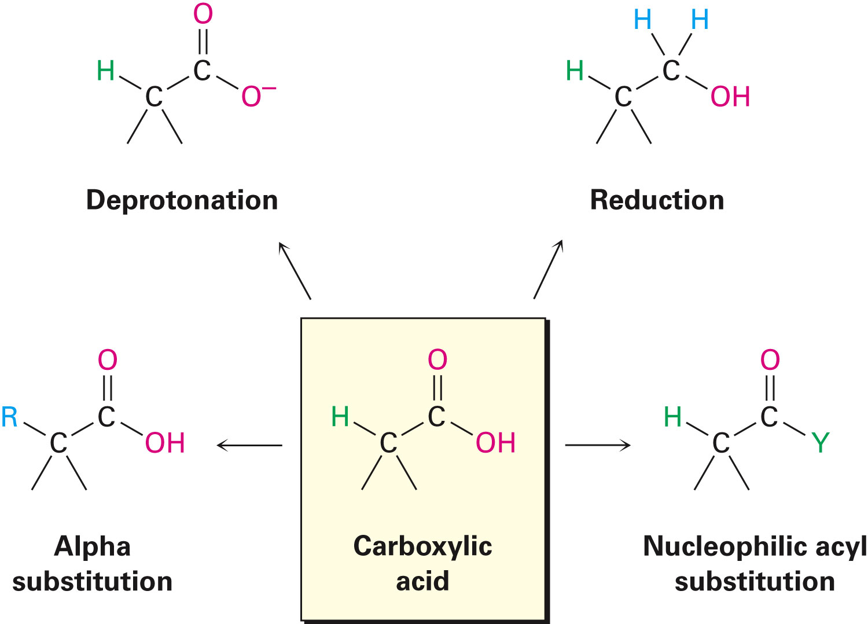
Figure 20.2 - Some General Reactions of Carboxylic Acids
Notes:
Reactions of carboxylic acids: An overview

Slide 32
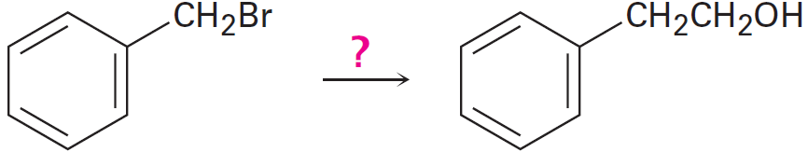
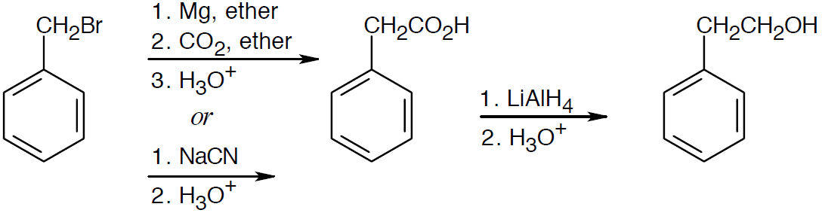
Worked Example
How 2-phenylethanol prepared from benzyl bromide?
Solution:
Notes:
Reactions of carboxylic acids: An overview

Slide 33
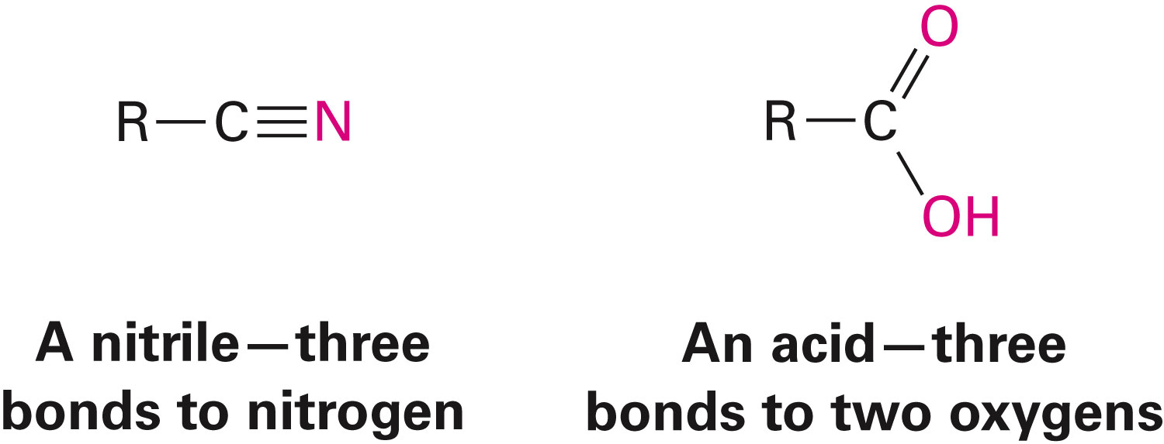
Chemistry of Nitriles
Has a carbon atom with three bonds to an electronegative atom, and contain a π bond
Are electrophiles and undergo nucleophilic addition reactions
Rare occurrence in living organisms
Notes:
Chemistry of nitriles

Slide 34
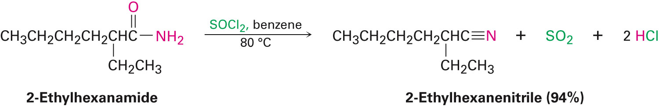
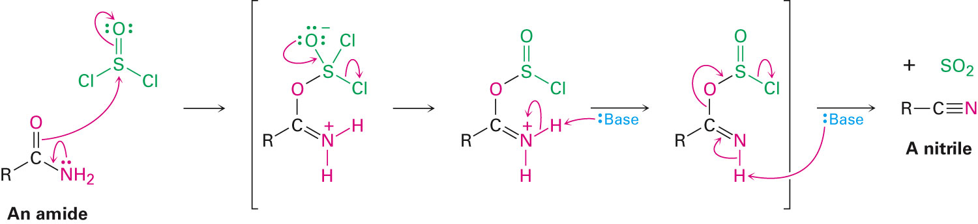
Chemistry of Nitriles
Preparation of Nitriles
S_{N}2 reaction of CN– with 1°or 2°alkyl halide
Also prepared by dehydration of primary amides RCONH₂
Nucleophilic amide oxygen atom attacks SOCl₂ followed by deprotonation and elimination
Notes:
Chemistry of nitriles

Slide 35
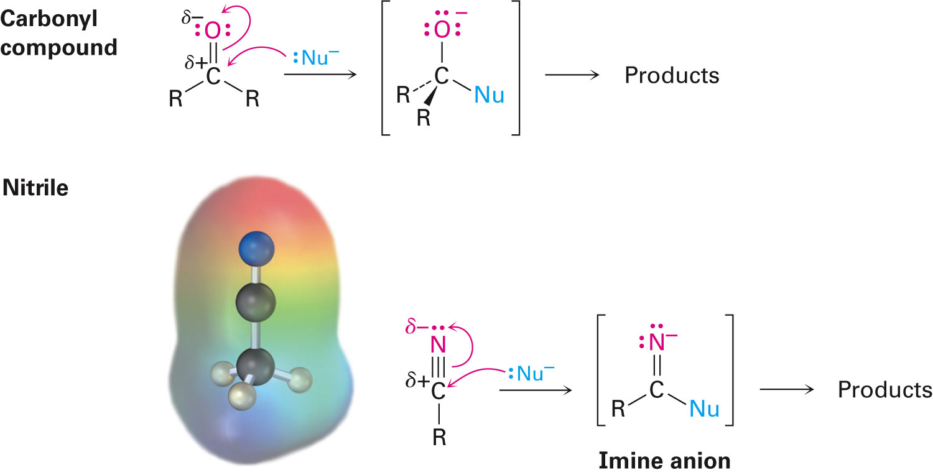
Chemistry of Nitriles
Reaction of nitriles
Strongly polarized and has an electrophilic carbon atom
Attacked by nucleophiles to yield sp²-hybridized imine anions
Notes:
Chemistry of nitriles

Slide 36
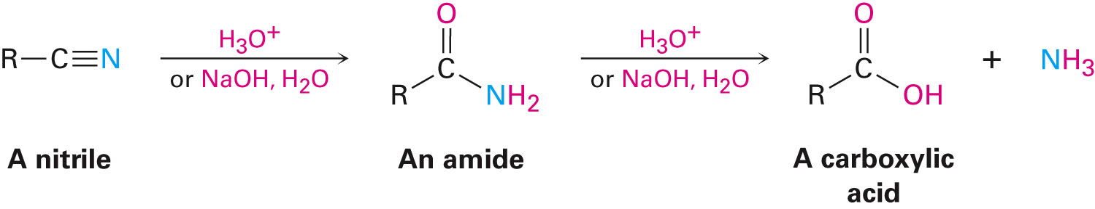
Chemistry of Nitriles
Hydrolysis - Conversion of nitriles into carboxylic acids
Nitriles are hydrolyzed in with acid or base catalysis to a carboxylic acid and ammonia
Notes:
Chemistry of nitriles

Slide 37
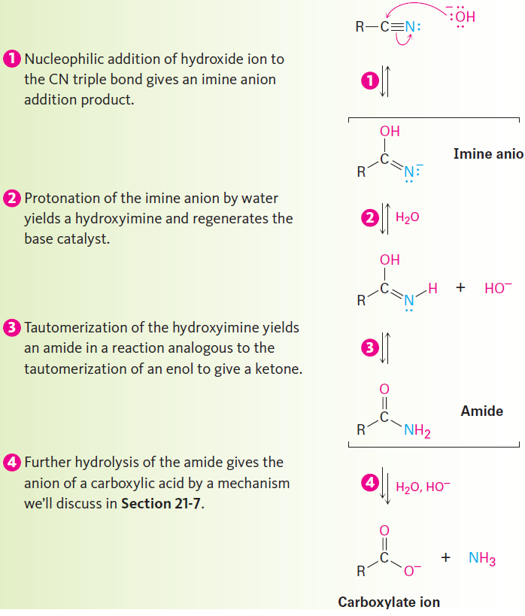
Figure 20.4 - Mechanism of Hydrolysis of Nitriles
Notes:
Chemistry of nitriles

Slide 38
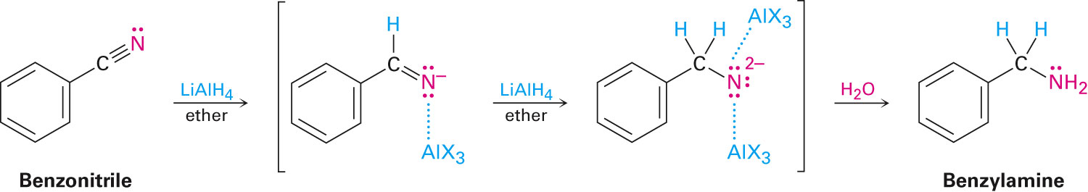
Chemistry of Nitriles
Reduction - Conversion of nitriles into amines
Reduction of a nitrile with LiAlH₄ gives a primary amine
Nucleophilic addition of hydride ion to the polar C≡N bond, yields an imine anion
The C=N bond undergoes a second nucleophilic addition of hydride to give a dianion, which is protonated by water
Notes:
Chemistry of nitriles

Slide 39
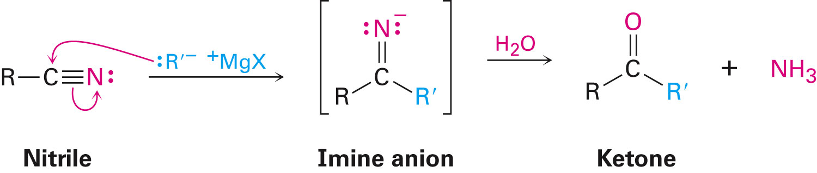
Chemistry of Nitriles
Reaction of nitriles with Grignard reagents
Add to give an intermediate imine anion that is hydrolyzed by addition of water to yield a ketone
Notes:
Chemistry of nitriles

Slide 40
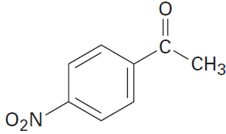
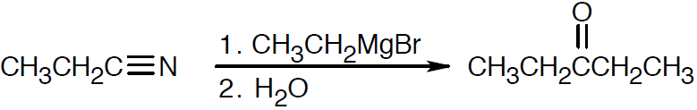
Worked Example
How is the following carbonyl compound prepared from a nitrile?
Solution:
Synthesized by a Grignard reaction between propane-nitrile and ethyl-magnesium bromide
Notes:
Chemistry of nitriles

Slide 41
Spectroscopy of Carboxylic Acids and Nitriles
Infrared spectroscopy
O–H bond of the carboxyl group gives a very broad absorption at 2500 to 3300 cm⁻¹
C=O bond absorbs sharply between 1710 and 1760 cm⁻¹
Free carboxyl groups absorb at 1760 cm⁻¹
Commonly encountered dimeric carboxyl groups absorb in a broad band centered around 1710 cm⁻¹
Notes:
Spectroscopy of carboxylic acids and nitriles

Slide 42
IR of Nitriles
Nitriles show an intense C≡N bond absorption near 2250 cm⁻¹ for saturated compounds and 2230 cm⁻¹ for aromatic and conjugated molecules
Highly diagnostic for nitriles
Notes:
Spectroscopy of carboxylic acids and nitriles

Slide 43
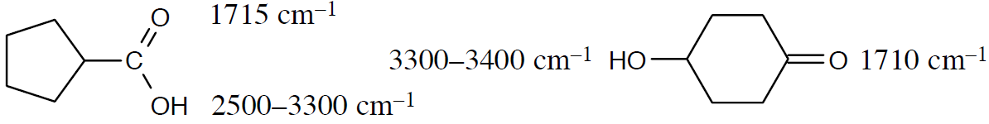
Worked Example
Cyclopentanecarboxylic acid and 4-hydroxycyclohexanone have the same formula (C₆H₁₀O₂), and both contain an –OH and a C=O group
How can they be distinguished using IR spectroscopy
Solution:
Notes:
Spectroscopy of carboxylic acids and nitriles

Slide 44
Worked Example
The –OH absorptions are sufficiently different
The broad band of the carboxylic acid hydroxyl group is especially noticeable
Notes:
Spectroscopy of carboxylic acids and nitriles

Slide 45
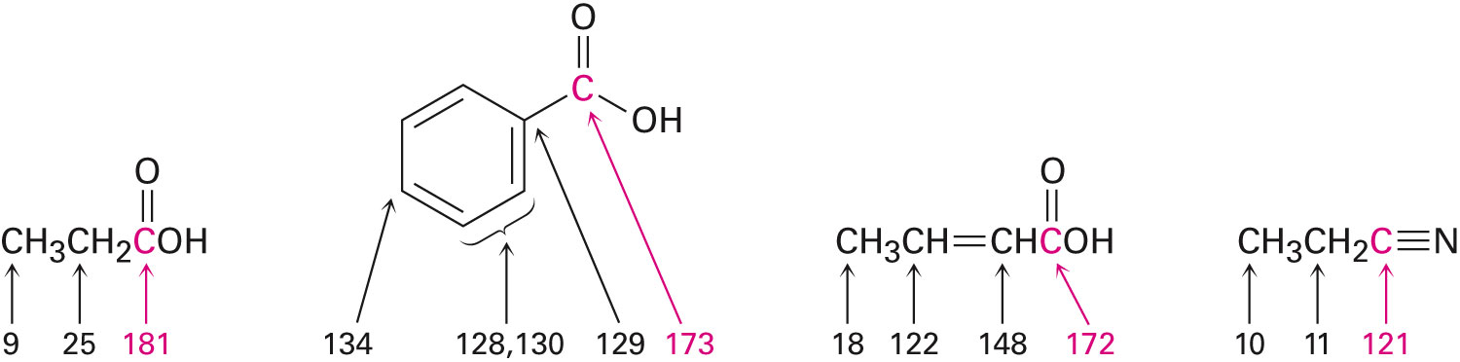
Nuclear Magnetic Resonance Spectroscopy
Carboxyl signals are absorbed at 165 δ to 185 δ
Aromatic and α,β-unsaturated acids are near 165 δ and saturated aliphatic acids are near 185 δ
Nitrile carbons absorb in the range 115 δ to 130 δ
Notes:
Spectroscopy of carboxylic acids and nitriles

Slide 46
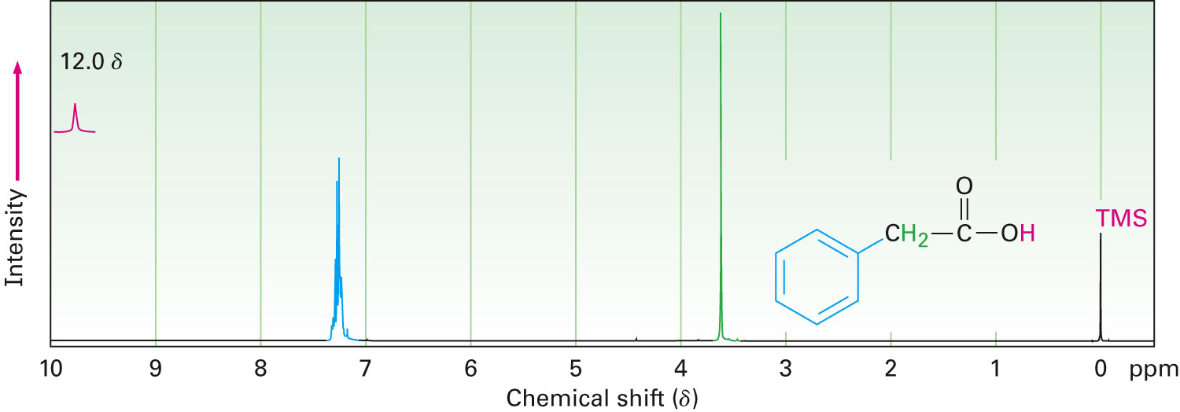
Proton NMR
The acidic –CO₂H proton is a singlet near 12 δ
When D₂O is added to the sample the –CO₂H proton is replaced by deuterium causing the absorption to disappear from the NMR spectrum
Notes:
Spectroscopy of carboxylic acids and nitriles

Slide 47
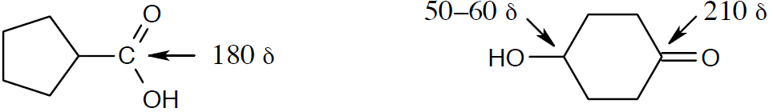
Worked Example
How could you distinguish between the isomers cyclopentanecarboxylic acid and 4-hydroxycyclohexanone by ¹³C NMR spectroscopy?
Solution:
Positions of the carbonyl carbon absorptions can be used to distinguish between the two compounds
Hydroxyketone shows an absorption in the range 50–60 δ
Notes:
Spectroscopy of carboxylic acids and nitriles

Slide 48
Summary
Carboxylic acids are among the most useful building blocks for synthesizing other molecules
Nitriles are compounds containing the –C≡N functional group
Extent of dissociation of a carboxylic acid in a buffered solution of a given pH can be calculated with the Henderson–Hasselbalch equation
Carboxylation is the reaction of Grignard reagents with CO₂

